Slide 1
Exomes vs. Panels: Snapshots
Leonor Palmeira & Pierre Lecocq

Slide 2
Means of Coverage per Target (Regions – Concatenation of Probes; 1/3)
Some Numbers
Columns 1, 3 & 5
3 Datasets (41497 Targets)
Cumulative
Columns 2, 4 & 6:
Per Class
Remaining
Columns 2, 4 & 6 in %
Columns 2, 4 & 6 in % (cumulative)

Slide 3
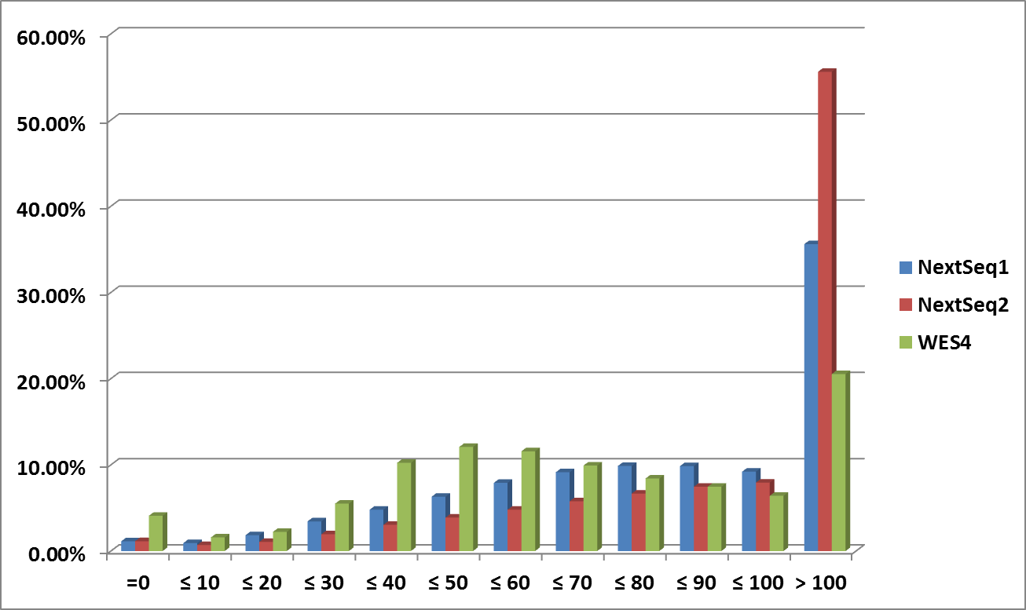
Means of Coverage per Target (2/3)
Some Graphs (1/2)

Slide 4
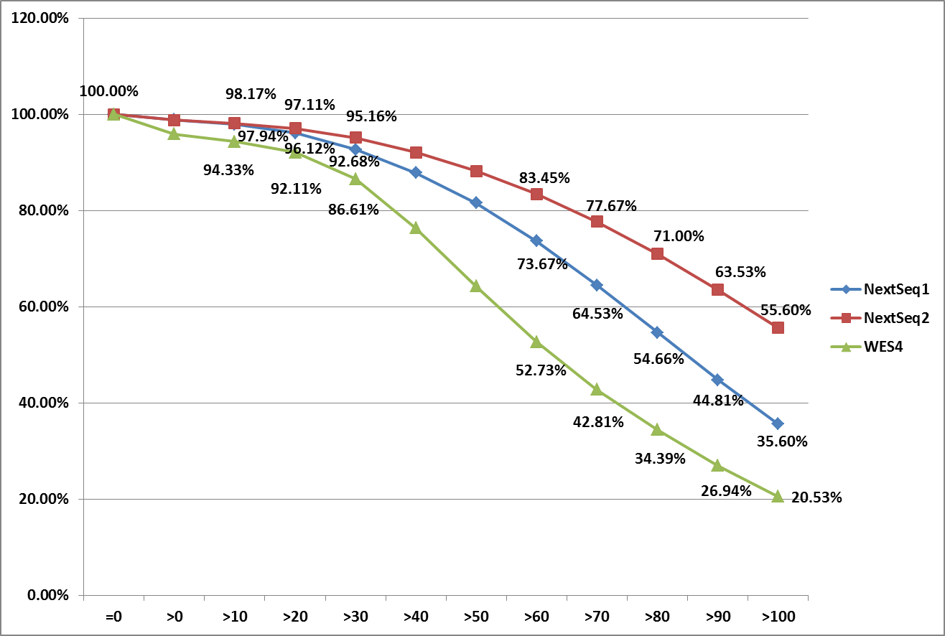
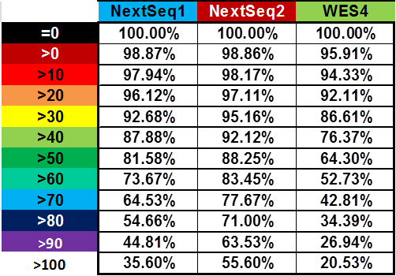
Means of Coverage per Target (3/3)
Some Graphs (2/2)

Slide 5
Analysis of Coverages: Discussion / Conclusions
Coverage (Global): WES << SeqNext 1 < (≈) SeqNext2
Failed Targets (=0 &/or <10): WES >> SeqNext 1 > (≈) SeqNext2
The more probes (genes) the lower coverage!
Agilent
WES: > 20,000 Genes
Inherited Diseases 2,701 Genes
CHU Ulg DG25 (SureDesign Agilent; 98,41% coverage): 750 Genes

