Slide 1
Exomes vs. Panels
Leonor Palmeira & Pierre Lecocq

Slide 2
Overview
1. « Quality of Coverage ».
Input: Bam Files from 3 NGS subsets (+/- 10 samples each): NextSeq1, NextSeq2 & WES4.
Targets BED file ( = regions made from concatenated contiguous probes ; Agilent SureSelect Inherited Diseases)
Picard Tools: Produces Output files containing (not only) Mean coverage per position within Targets (HS ONLY: The more stringeant)
2. « CUGD coverage ».
Input = BEDs Files from Agilent SureSelect Inherited Diseases & Agilent CUDG SureDesign (custom, specific)
Perl code to identify (nuc by nuc) % of coverage of CUDG genes
3. « Gene / Domain Duplication ».
Input = HG38 FASTA files (chromosomes) & Codex FASTA files
FormatDB, Blastall and Perl code. Review possible gene/domain duplication.
Important: Threshold set at > 21 Nuc.

Slide 3
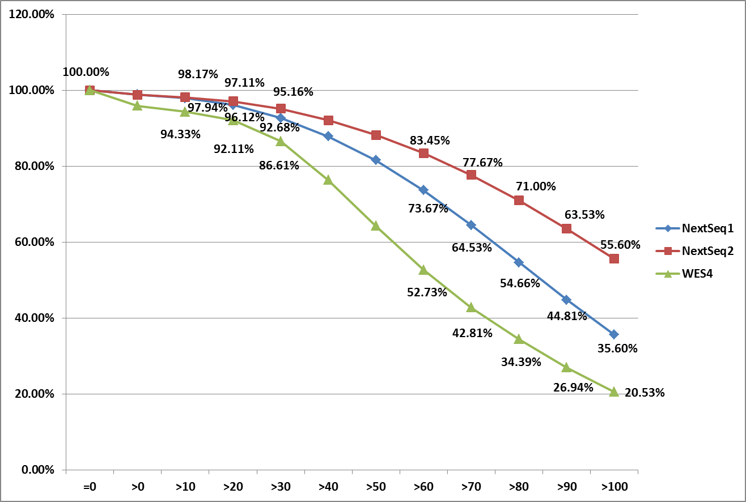
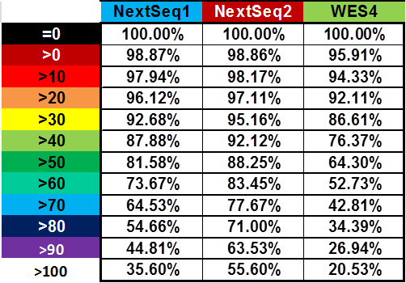
Quality of Target Coverage: NextSeq1, NextSeq2 & WES4
Picard Tool; for Targets from Agilent SureSelect Inherited Diseases
≤ 10-9 chances to fail identifying second allele
Important: Reads Counts!

Slide 4
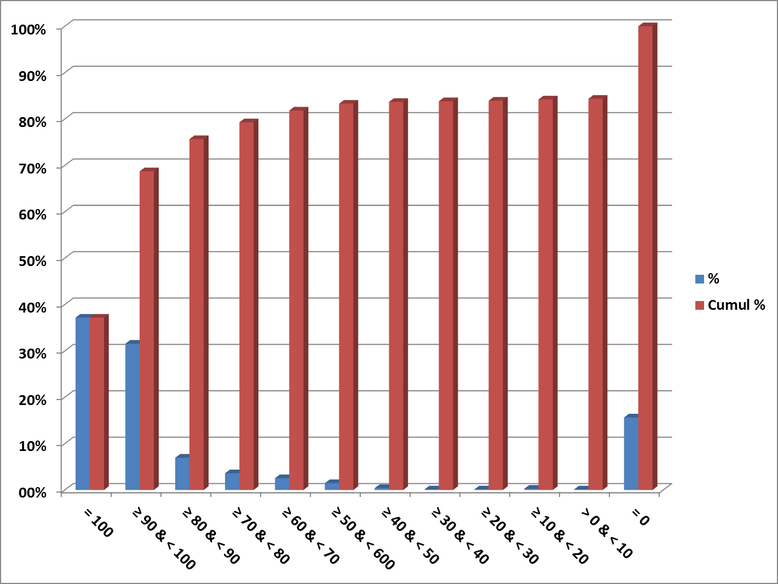
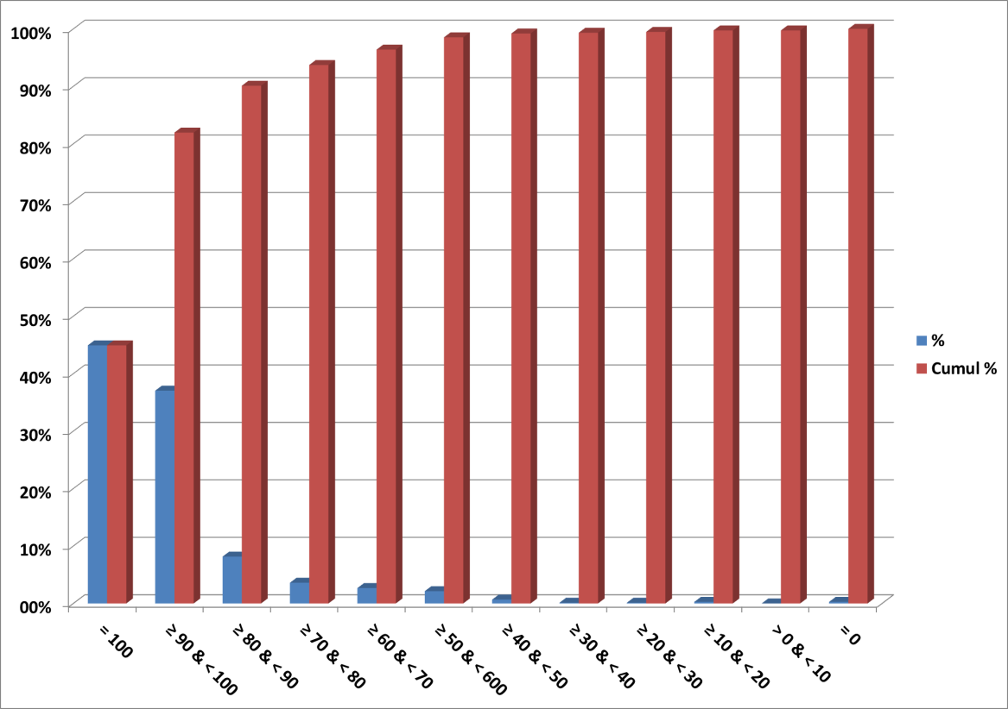
CUGD (748 Genes) % Codex Coverage (BEDs analyses)
Agilent Inherited Diseases Targets
(> 130,000 probes, > 40,000 Targets)
Agilent CUGD custom Targets
(> 40,000 probes, > 12,000 Targets)
x 1/3
QC coverage
Important:
CUGD is optimal
For Agilent
(inclusive Exomes)

Slide 5
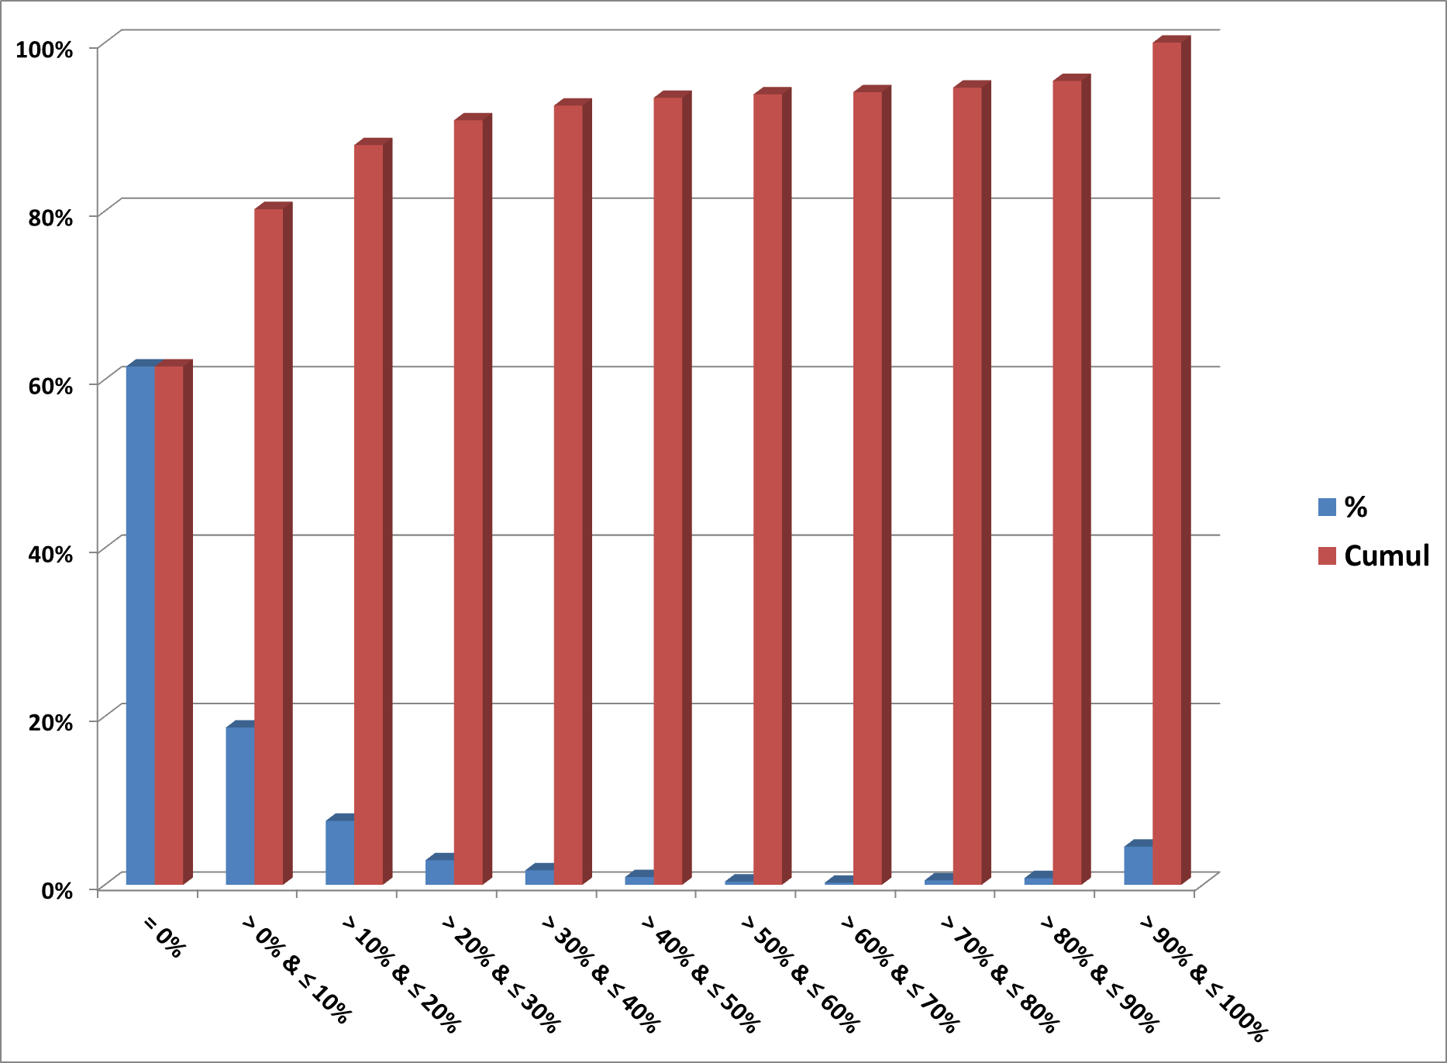
Gene / Domain Duplication
Threshold at > 21 Nuc.
% = (Codex Warning + Codex Failed) / Codex
Domains
Pseudos or
Duplicated ?

Slide 6
Discussion/Conclusion/What’s Next?
1. « Quality of Coverage ».
In real experimental conditions, definitive better enrichement with Agilent SureSelect Inherited Diseases vs. Whole Exome for targeted (ASID) genes.
Important: Fluctuations in outcomes using ASID kit && to be considered/evalated in the light of global reads counts.
2. « CUGD coverage ».
ASID will miss completely > 15% of CUGD selected genes and also have partial covering of numerous additionnal ones.
Also even at best (for Agilent) this partial covering remains. But number of completely « missed » genes is strongly reduced.
Important: There is a cost: 150/200 Euros / Sample with ASID, + 50/100 Euros with dedicated kit.
3. « Gene / Domain Duplication ».
About 5% of genes (CUGD) will definitively lead to controversal results as having pseudo / duplicated genes. And about another 35% of genes will have « domains »
Homology also contaminating results (Survey / Flag)
Important: Threshold set at > 21 Nuc.
What’s Next?
New CUGD. Update and define as first official version. Repeat analyses on current datasets and decide (incl. Clinicians) about the NGS (ASID vs. CUGD) strategy (3-4 weeks?).

